Slide 1





REAL-TIME ROBOT NAVIGATION WITH QR-BASED
LOCALIZATION AND LIDAR OBSTACLE MAPPING
Alaa Hussein Baraa Lazkani Haidar Saad Humam Yehia
Supervised by:
Fadi Muttauag
Baher Kher-Bek

Slide 2



Table Of Contents
Introduction
Hardware and Software
Systems Architecture
Theoretical Background
Methodology
Conclusion and Future Work

Slide 3


1
Introduction
1

Slide 4
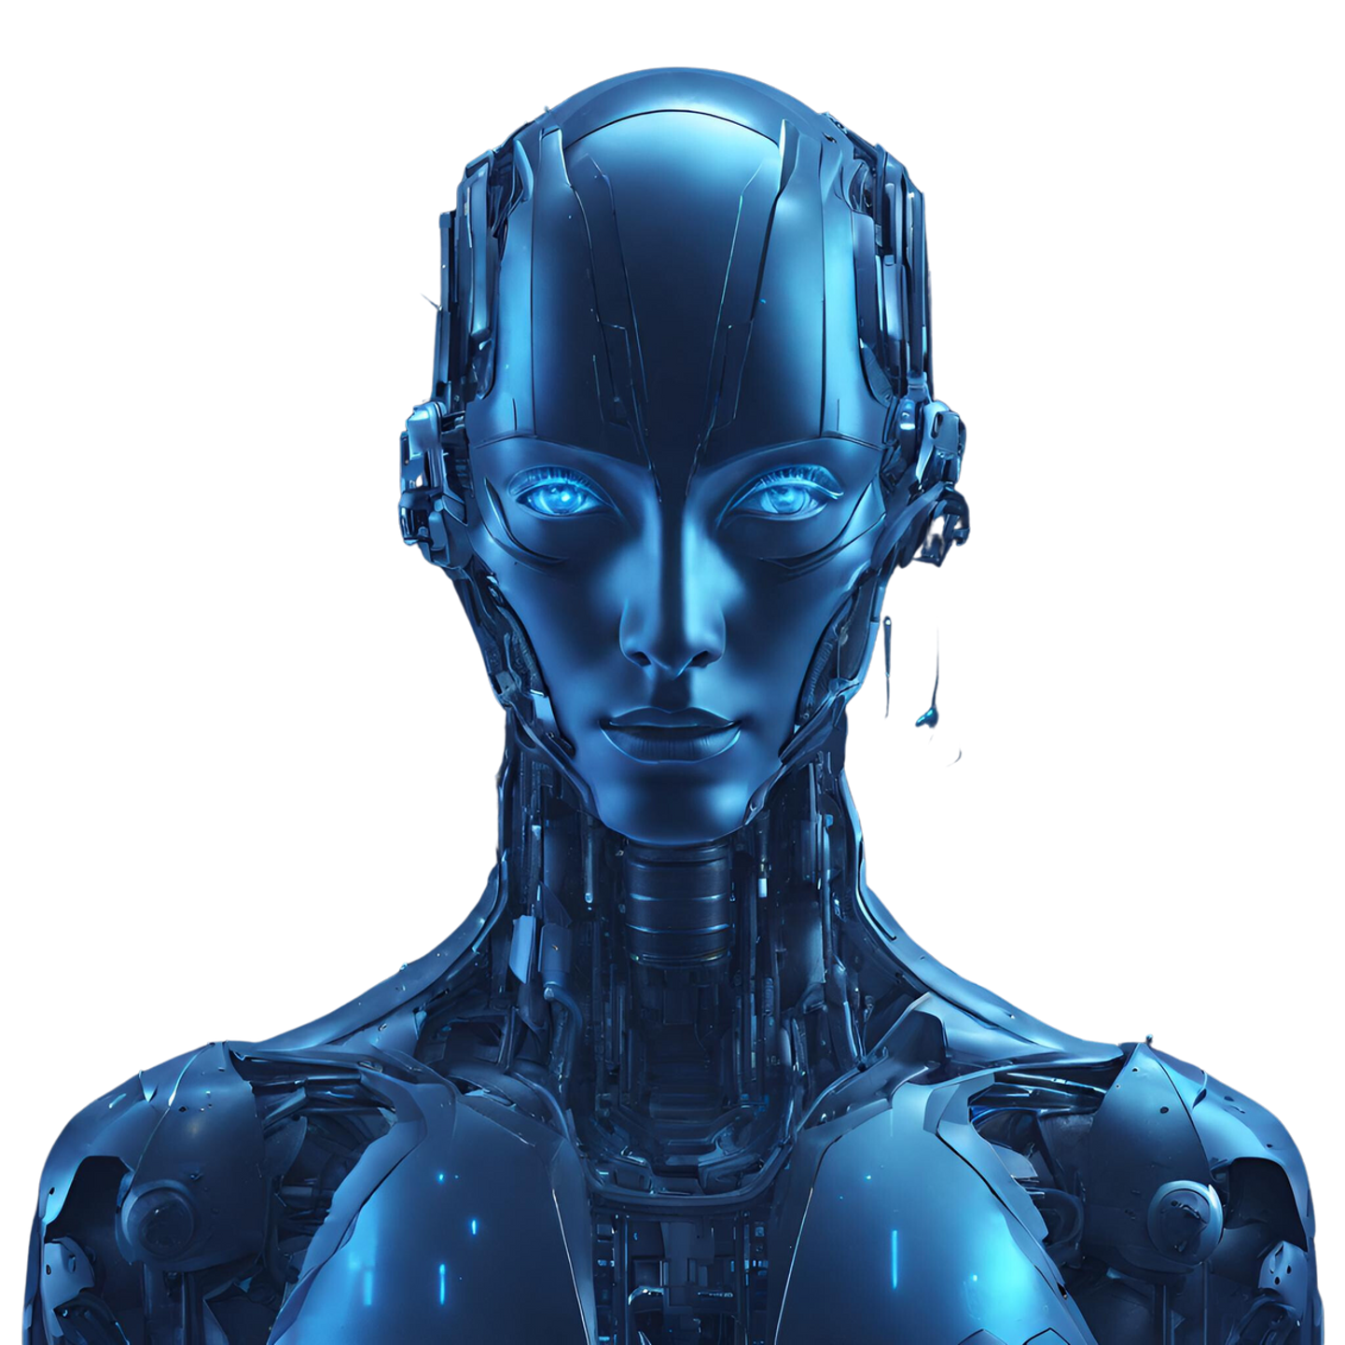
2
Hardware and Software
Systems Architecture
2

Slide 5
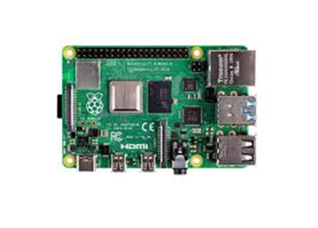
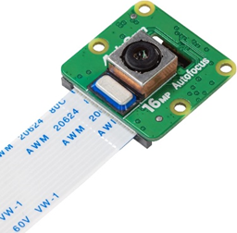
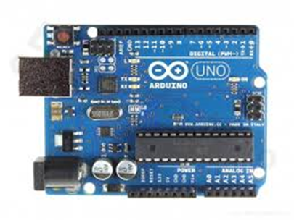
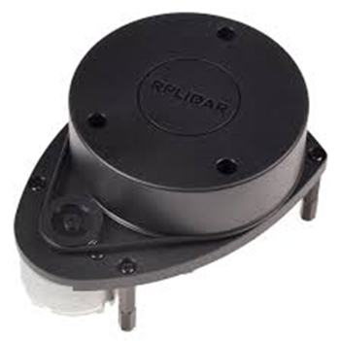
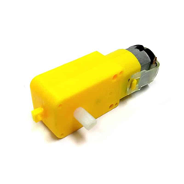
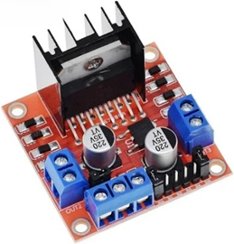
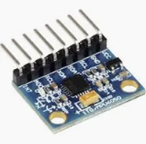
Hardware Components
Raspberrypi 4 Model B
Arducam 16 MP
Arduino Uno R3
RP Lidar A18M
DC Motor
L298 Motor Driver
MPU6050
3

Slide 6




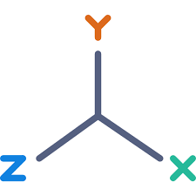

Software Architecture
Camera Input
ArUco Marker Detection
Coordinate Transformation
Serial Transmission
Pose Estimation & Filtering
Navigation and Control
4

Slide 7
Software Architecture
Camera Input
ArUco Marker Detection
Coordinate Transformation
Serial Transmission
Pose Estimation & Filtering
Navigation and Control
4

Slide 8
Software Architecture
Camera Input
ArUco Marker Detection
Coordinate Transformation
Serial Transmission
Pose Estimation & Filtering
Navigation and Control
4

Slide 9
Software Architecture
Camera Input
ArUco Marker Detection
Coordinate Transformation
Serial Transmission
Pose Estimation & Filtering
Navigation and Control
4

Slide 10
Software Architecture
Camera Input
ArUco Marker Detection
Coordinate Transformation
Serial Transmission
Pose Estimation & Filtering
Navigation and Control
4

Slide 11
Software Architecture
Camera Input
ArUco Marker Detection
Coordinate Transformation
Serial Transmission
Pose Estimation & Filtering
Navigation and Control
4

Slide 12
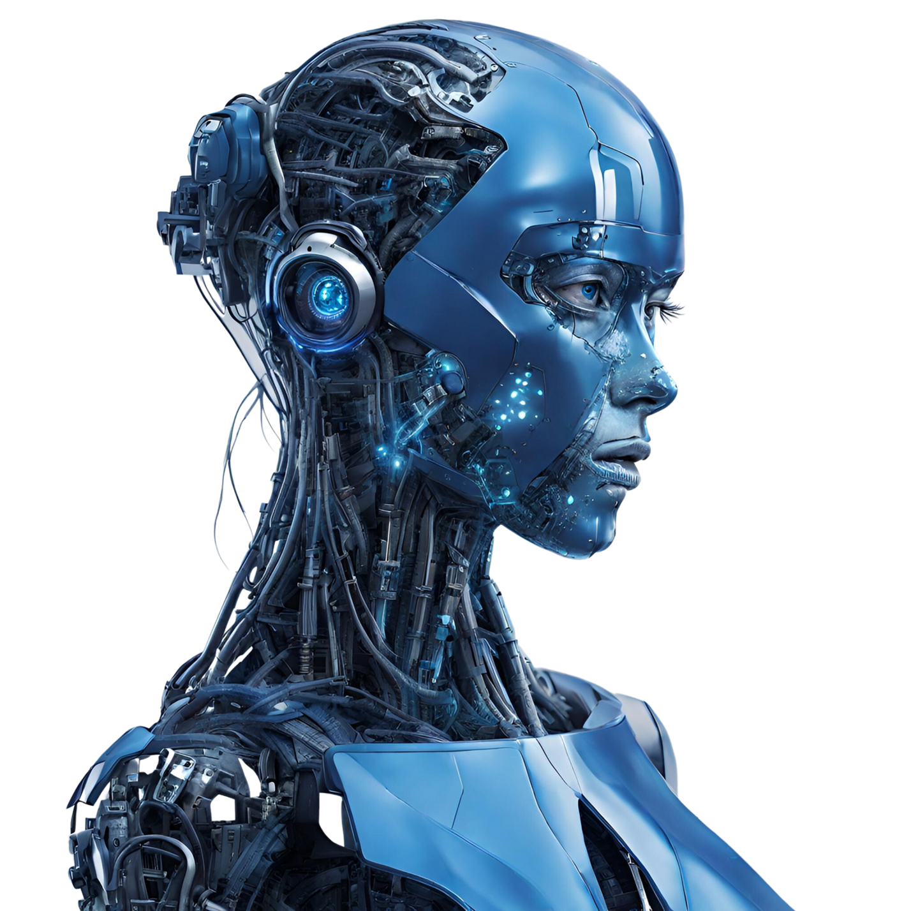
3
Theoretical Background
5

Slide 13
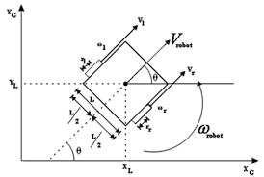






Differential‐Drive (Two-Wheeled)
Mobile Robot
Kinematic Model
$$v_l = r · ω_l v_r = r · ω_r$$
$$v =\frac{\left(v_{r}+ v_{l}\right)}{2} =\frac{\left[r · \left(ω_{r}+ ω_{l}\right)\right]}{2}$$
$$ω =\frac{v_{r}− v_{l}}{b}=\frac{\left[r · \left(ω_{r}− ω_{l}\right)\right]}{b}$$
$$ẋ = v · cos θ,$$
$$ẏ = v · sin θ,$$
$$θ′ = ω$$
$$ẋ = \left[r ·\frac{ω_{r}+ ω_{l}}{2}\right] · cos θ$$
$$ẏ = \left[r ·\frac{ω_{r}+ ω_{l}}{2}\right] · sin θ$$
$$θ̇′ = \left[r ·\frac{ω_{r}− ω_{l}}{b}\right]$$
Inverse Kinematic Model
$$ω_{r}=\frac{\left[v + \left(\frac{b}{2}\right)· ω\right]}{r}$$
$$ω_{l}=\frac{\left[v − \left(\frac{b}{2}\right)· ω\right]}{r}$$
6

Slide 14

Kalman Filter
Linear Kalman Filter
Non-Linear Model
Extended Kalman Filter
$$x_{k}=F_{k−1}x_{k−1}+G_{k−1}u_{k−1}$$
$$x_{k}=f(x_{k−1},u_{k−1},w_{k−1})$$
$$x_{k}=f(x_{k−1},u_{k−1})$$
$$P_{k}=F_{k−1}P_{k−1}F_{k−1}^{T}+Q_{k−1}$$
$$z_{k}=h(x_{k},v_{k})$$
$$P_{k}=F_{k−1}P_{k−1}F_{k−1}^{T}+L_{k−1}Q_{k−1}L_{k−1}^{T}$$
$$K_{k}=P_{k}H_{k}^{T}{\left(H_{k}P_{k}H_{k}^{T}+M_{k}R_{k}M_{k}^{T}\right)}^{−1}$$
$$K_{k}=P_{k}H_{k}^{T}{\left(H_{k}P_{k}H_{k}^{T}+R_{k}\right)}^{−1}$$
$$x_{k}=x_{k}+K_{k}\left(z_{k}−h(x_{k})\right)$$
$$x_{k}=x_{k}+K_{k}\left(z_{k}−H_{k}x_{k}\right)$$
$$P_{k}=\left(I−K_{k}H_{k}\right)P_{k}$$
$$P_{k}=\left(I−K_{k}H_{k}\right)P_{k}$$
7

Slide 15

4
Methodology
8

Slide 16
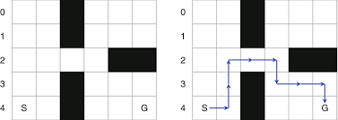
Path Planning using Dijkstra
4
Let’s consider the following static map:
9

Slide 17
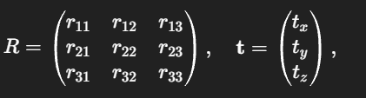
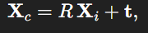
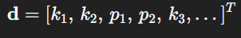
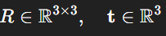
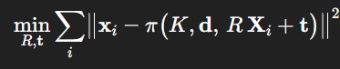
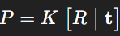
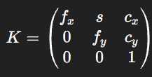
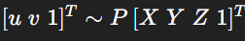
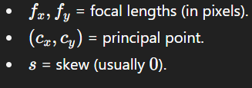

ArUco Marker-Based Robot Localization System
We consider a 3D point in camera coordinates:
We must also supply a distortion vector that models radial (𝑘) and tangential (𝑝) lens distortion.
Now we can build the full extrinsic matrix:
SolvePnP minimizes the reprojection error:
Thus, now we can get the complete projection matrix as follows:
Before we can relate 3D→2D, we must know our camera’s intrinsic calibration:
Now we can get the position of the point in the plane as follows:
The output of SolvePnP will be (Rodrigues form) such that:
rvec: a $3×1$ rotation vector.
tvec: a $3×1$ translation vector.
10

Slide 18
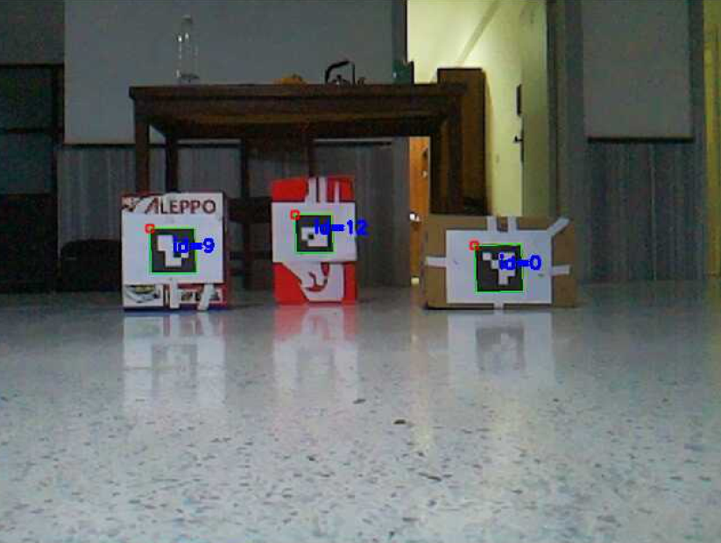
ArUco Marker-Based Robot Localization System
11

Slide 19
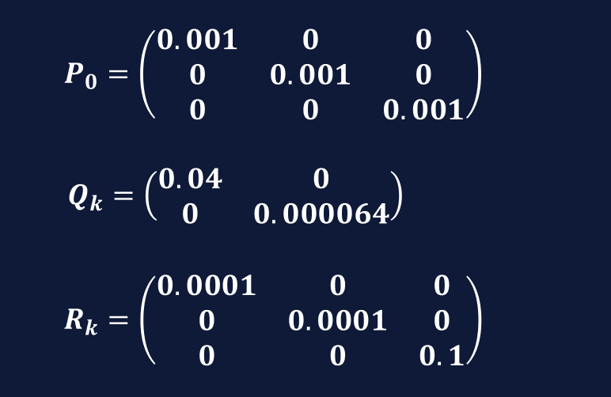
Robot Localization Using Kalman Filter
12

Slide 20







Robot Localization Using Kalman Filter
$$x_{k}=x_{k−1}+dt∗\left(\begin{matrix}\left(v+w_{v}\right)cos(θ) \\ \left(v+w_{v}\right)sin(θ) \\ \left(ω+w_{ω}\right)\end{matrix}\right)$$
$$z_{k}=x_{k}+v_{k}$$
$$F_{k−1}= \frac{∂f}{∂x_{k−1}}=\left(\begin{matrix}1 & 0 & −dt∗v∗sin(θ) \\ 0 & 1 & dt∗v∗cos(θ) \\ 0 & 0 & 1\end{matrix}\right)$$
$$H_{k}=\frac{∂h}{∂x_{k}}=I$$
$$L_{k−1}=\frac{∂f}{∂w_{k−1}}=dt∗\left(\begin{matrix}cos(θ) & 0 \\ sin(θ) & 0 \\ 0 & 1\end{matrix}\right)$$
$$M_{k}=\frac{∂h}{∂v_{k}}=I$$
prediction$(imu_meas, dt)$
update$(z_t, z_count)$
13

Slide 21
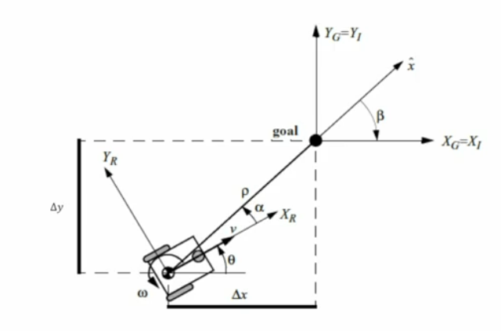
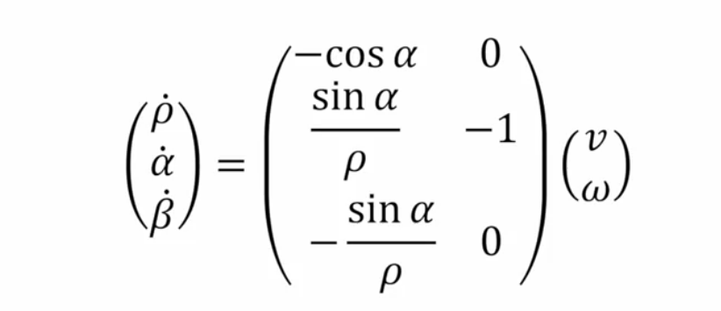
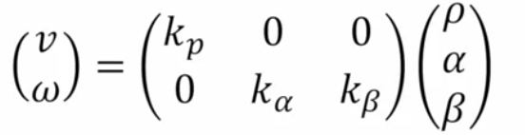
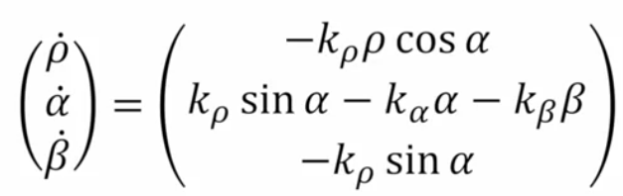
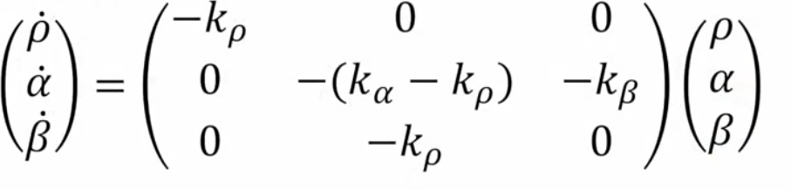
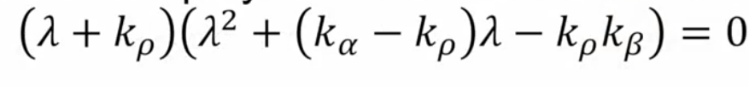
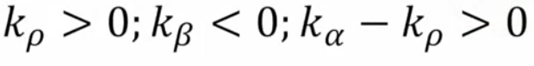





Motion Control
$$ρ=\sqrt{{\left(x_{g}−x\right)}^{2}+{\left(y_{g}−y\right)}^{2},}$$
$$α=−θ+\tan^{−1}{\frac{y_{g}−y}{x_{g}−x},}$$
$$β=−θ−α$$
$ω=k_{a}.α$ + $k_{β}.β$
$$v=k_{p}.ρ$$
14

Slide 22
LIDAR-Based Navigation Algorithm (Inspired by Dynamic Window)
1
2
3
4
Data Segmentation
Obstacle Inflation:
Goal Direction Search
Incremental Planning
15

Slide 23
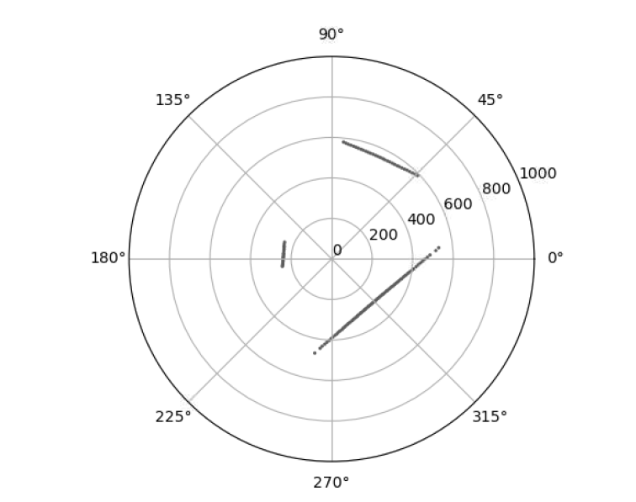
LIDAR-Based Navigation Algorithm (Inspired by Dynamic Window)
16

Slide 24


17
5
Conclusion and Future Work

Slide 25
Thank you!

